Slide 1
HEX WRENCH / ALLEN KEY
ARAVIND RAMESH
MPD18I003

Slide 2
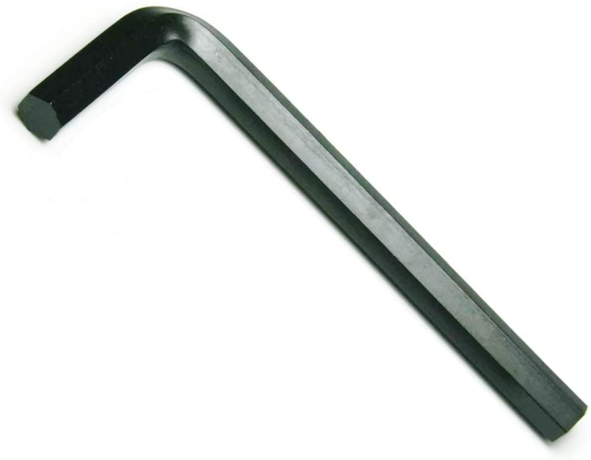
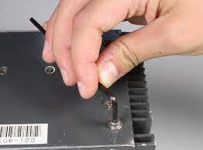
Hex wrench
Hex wrench / Allen key is a simple tool which is used to drive bolts and screws with hexagonal sockets in their heads. The tool is a hexagonal shaped rod, which is “L” shaped with unequal arms. When twisted with the long arm, it creates a large torque at the tip of the short arm.
The tool is of various sizes, hence they are sold in kits as they serve their purpose according to the size of the socket. It is cheap to manufacture and simple, small and tight.

Slide 3
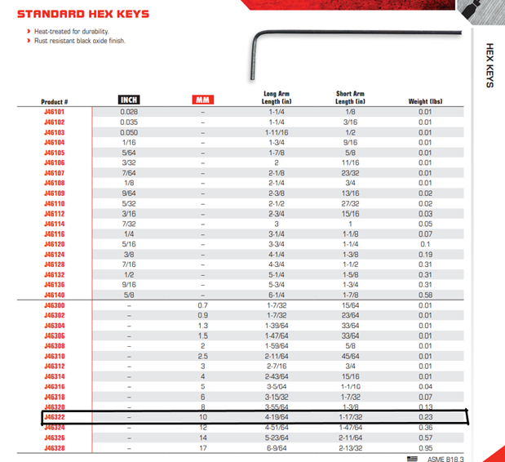
STANDARD INFORMATION
All dimensions was taken from PROTO catalog and the
dimensions are:
Radius = 0.5 cm
Long arm length = 10.8966 cm (4-19/64 inches)
Short arm length = 3.8862 cm (1-17/32 inches)
Fillet radius = 0.5 cm
Force applied = 20 N (taken)
Moment applied = 10 N.cm (in both directions)(taken)
These values were considered while doing structural analysis in APDL interface.

Slide 4
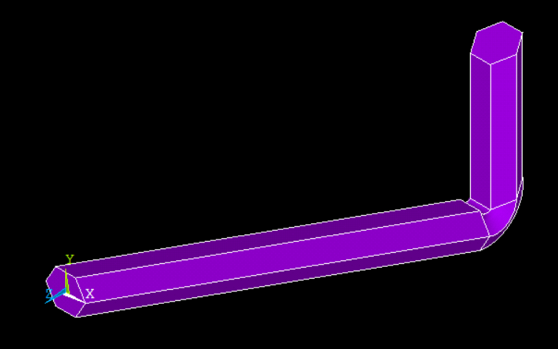
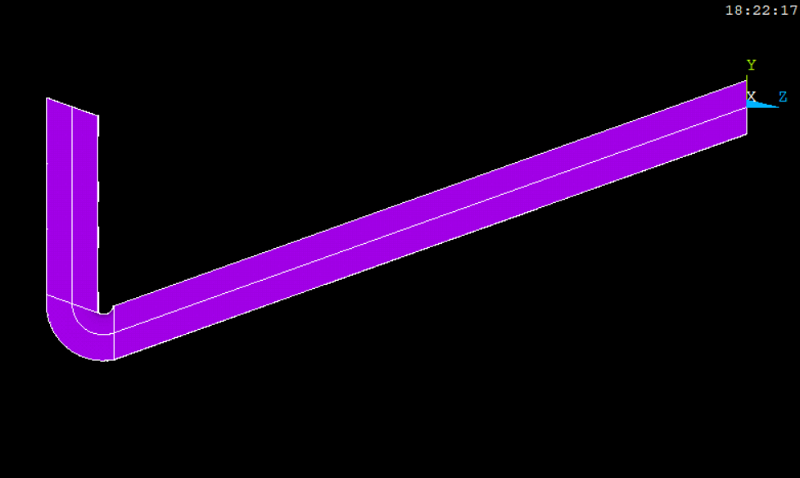
Fig 1. isometric view of the hex wrench
Fig 2. left view of hex wrench
Fig 1 shows the complete (isometric) model of the hex wrench.
Fig 2 shows the left view of the same.

Slide 5
ANALYSIS PROCEDURE
Open preferences
Select Structural (since it is our domain of interest)
Open Preprocessor menu
Choose Element type>Add/Edit/Delete. Add SOLID 185 (brick 8 node 185) as the element type. Also add PLANE 182 (quad 4 node 182) as the element type.
Choose Material props> Material models> Structural> Linear> Elastic> Isotropic, Modulus of elasticity(EX)= 2.07e7 N/cm2 and Poisson’s Ratio (PRXY) = 0.3 of the material of interest, which is steel.
Creation of Area. Choose Modeling> Create>Area> Polygon> Hexagon. Hexagon with radius 0.5 cm was created.

Slide 6
Creation of Keypoints. Choose Modeling> Create> Keypoints> In Active CS. Keypoint numbers and corresponding coordinates are fed. First six keypoints correspond to the hexagon ends and 7,8 and 9 are created to extrude the hexagon into the shape of hex wrench. [ keypoints are: 7(0,0,0) & 8(0,0,-10.8966) & 9(0,-3.8862,-10.8966) ]
Choose Modelling>Create>Lines>Lines>Straight lines and connect keypoints 7,8 and 9. To fillet the wrench, choose Modelling>Create>Lines>Lines>Line fillet and give the radius (between the two lines) as 0.5 cm.
Choose Modelling>Operate>Extrude>Areas>Along Lines and extrude the hexagonal area along the two lines and fillet region to obtain the complete model of Hex wrench.

Slide 7
Choose Mesh>Mesh tools and select size controls with help of lines (which connects the keypoints). The element division is taken as 50. The mesh volume shape is hex/wedge-sweep and sweep. We then obtain the meshed body.
Now, choose Loads>Apply>Structural>Displacement>Along Areas and constrain the hexagonal area at the long end by giving displacement 0.
Choose Loads>Apply>Structural>Force/Moment>On Keypoints and select the keypoints to apply the given force and moment. In APDL, the force of 20N is applied on keypoint 24 and moment of 10 N.cm is applied on keypoint 25 and 29.

Slide 8
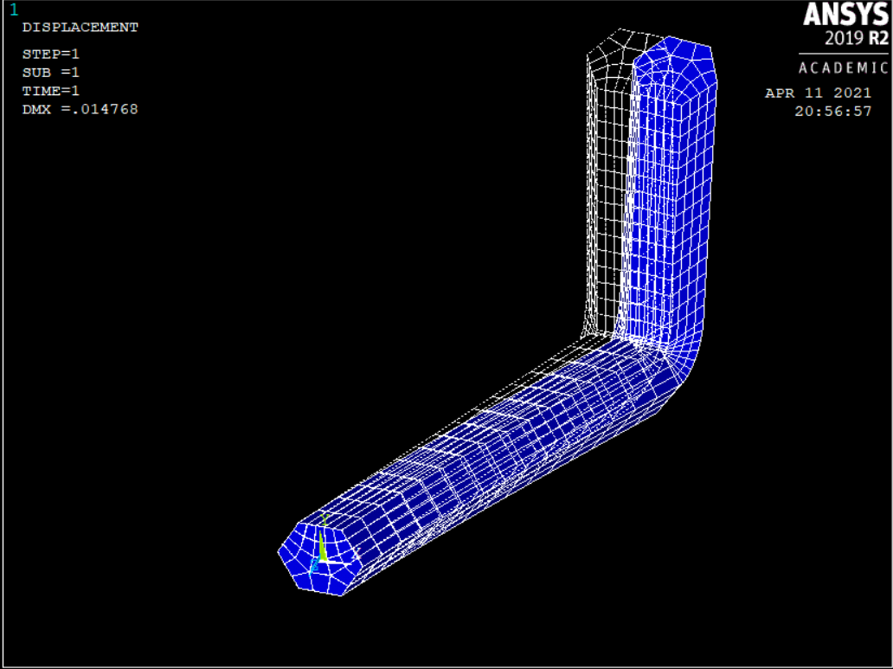
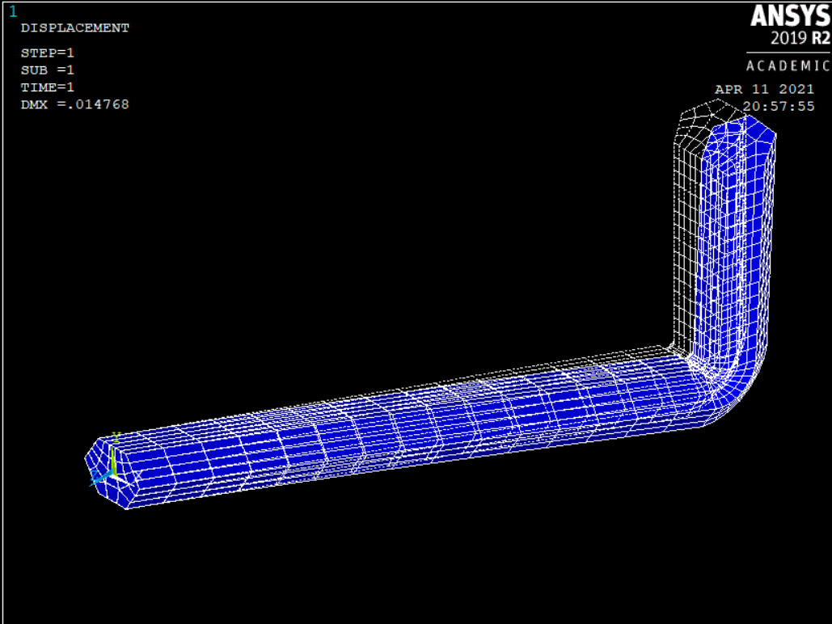
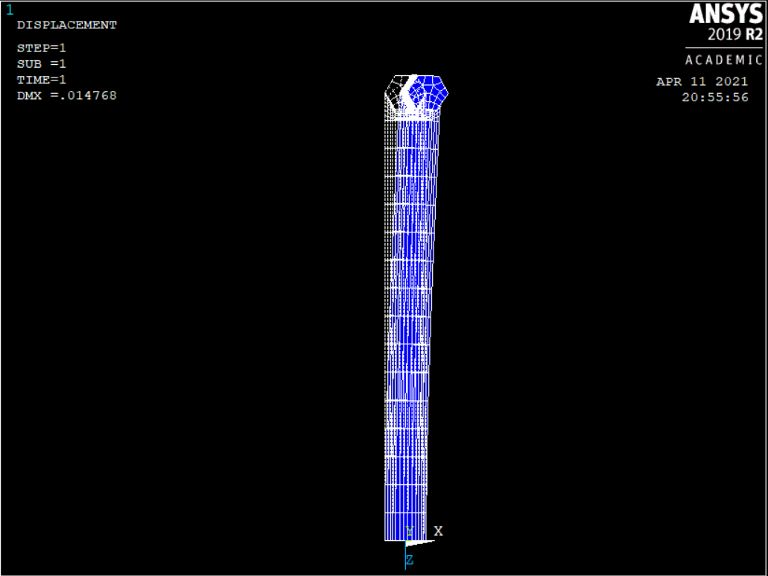
Results and discussions
Now after creating the model, solve it using the command Solution>Current LS>Solve
After solving, the deformed along with the undeformed shape can be viewed from the General post processing command.[ General postproc >Plot results >deformed shape ]
The deformed part of the body is clearly visible and DMX value came around 0.014768 cm.

Slide 9
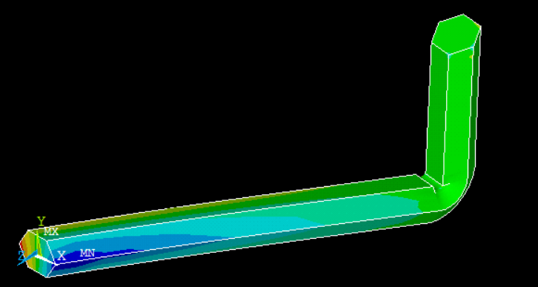
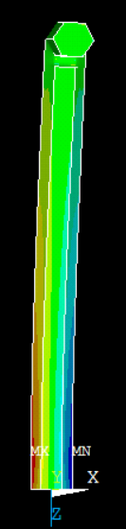
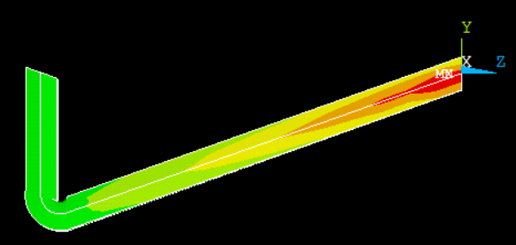
Given are the contour plots for the stress distribution in z-direction.
As we can see from right to left end of long arm, stress increases due to constraint given in the area. As we apply force and moment on the small arm part, eventually the tension and compression develops at end of long arm.
The maximum stress came out to be around 2230.32 MPa at the long arm left end. Here displacement constraint is applied at the hexagonal area of long arm and the stress developed there is shown in color variation (red to blue) as we can see in the figure.

Slide 10
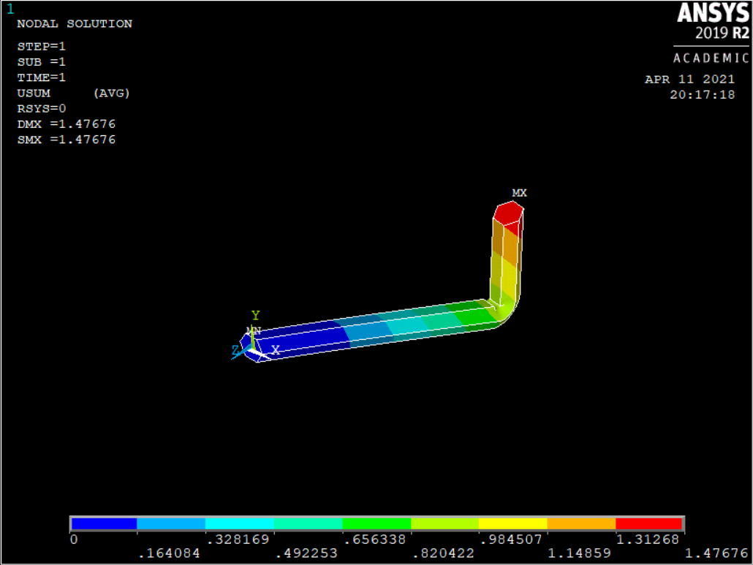
The maximum displacement occurs at the short arm end where the force and moment is applied, which is evenly distributed and the red color can be viewed.
The color varies uniformly from end of short arm to the long arm and color variation is shown in the figure.
The deformation is nearly zero at the end of long arm (hexagonal area) of the hex wrench.

Slide 11
CONCLUSION
The analysis was performed to study the structural analysis of the Hex Wrench while applying force on it.
We have learnt displacement and stress distribution when a given force & moment is applied.
Maximum displacement takes place at the end of short arm where we apply the force and moment.
Maximum stress intensity takes place at the left end of long arm.
The stress intensity at the short arm is always in the green region even though we constraint the area at the end of long arm and force & moment is applied at end of short arm.

